Slide 1

The Rise of Generative AI
This presentation explores the emergence and impact of generative AI. We'll delve into its capabilities, applications, and potential to reshape industries.

Slide 2
What is Generative AI?
Definition
How it works
Generative AI refers to a category of artificial intelligence capable of creating new content, such as text, images, audio, and video.
These models are trained on massive datasets and learn to identify patterns and relationships, enabling them to generate outputs that mimic human creativity.

Slide 3
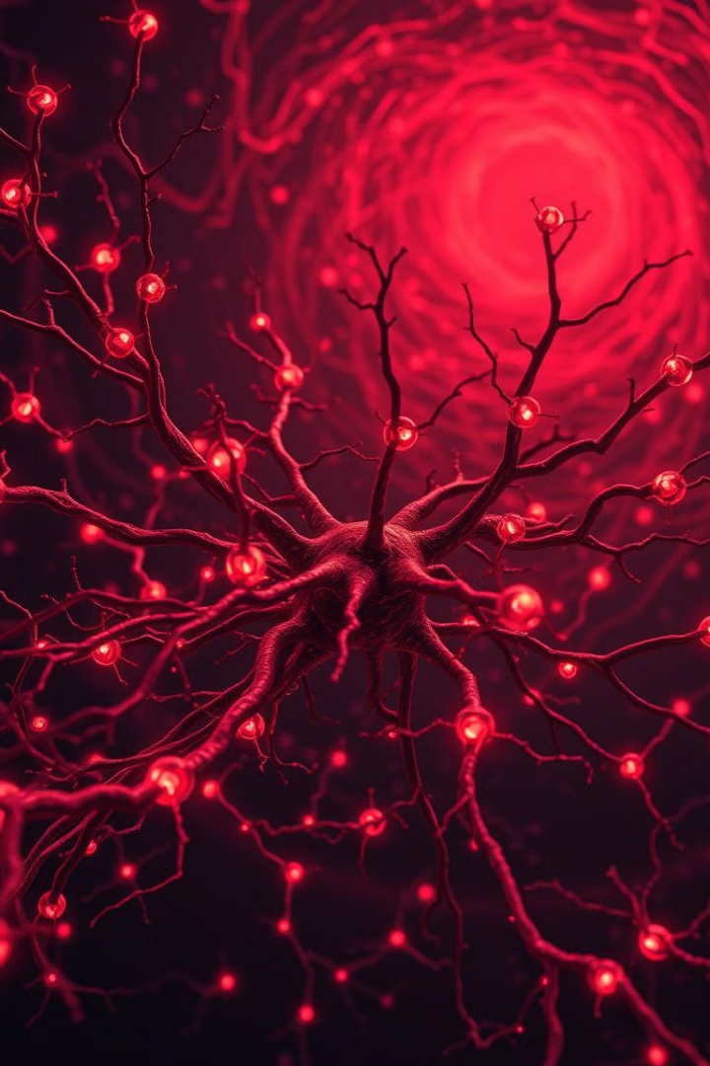
Key Advances in Generative AI
1
Deep Learning
The advent of deep learning has significantly enhanced the capabilities of generative models.
2
Transformer Networks
Transformer networks, like GPT-3 and BERT, have revolutionized natural language processing and enabled more sophisticated text generation.
3
Diffusion Models
Diffusion models have emerged as powerful tools for image and video generation, offering higher fidelity and more realistic outputs.

Slide 4
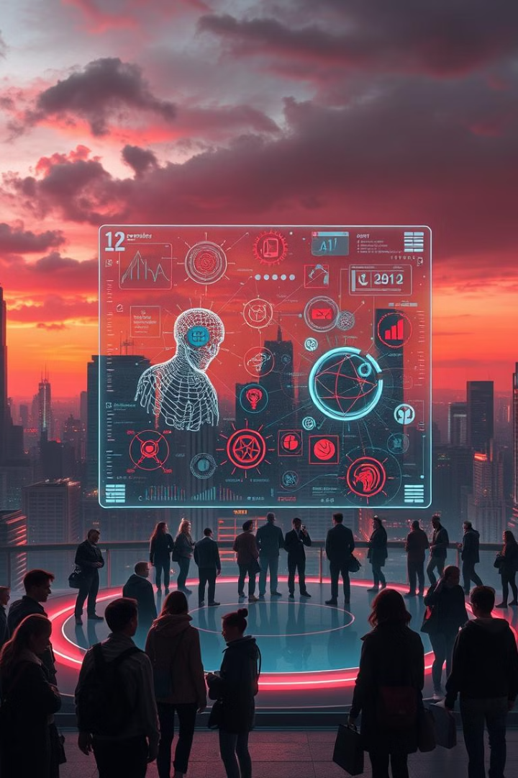
Generative AI Applications
Content Creation
Drug Discovery
Generative AI is transforming content creation across various media, including text, images, music, and video.
AI models are being used to accelerate the process of drug discovery, identifying potential candidates and optimizing molecular structures.
Personalized Education
Customer Service
Chatbots powered by generative AI are increasingly being used to provide efficient and personalized customer support.
Generative AI can personalize learning experiences by adapting to individual needs and providing tailored feedback.

Slide 5




Impact on Creative Professions
Augmentation
New Opportunities
Generative AI can augment the creative process, providing inspiration, tools, and assistance to artists and designers.
It opens up new possibilities for creative expression, allowing individuals to explore novel forms and styles.
Evolution of Craft
The role of creative professionals is evolving as AI tools become more sophisticated, requiring adaptation and collaboration.

Slide 6





Ethical Considerations in Generative AI
1
Bias
Misinformation
2
The potential for generating misleading or harmful content raises concerns about misinformation and its impact on society.
Privacy
3
Generative models require extensive training data, raising concerns about privacy and the responsible use of personal information.
Job Displacement
4
The automation capabilities of generative AI raise concerns about job displacement in creative and other industries.
Intellectual Property
5
The ownership and attribution of generative AI outputs raise questions about intellectual property rights and potential infringements.

Slide 7
Limitations and Challenges of Generative AI
Data Dependence
1
Generative AI models are heavily reliant on data quality and availability. Biased or incomplete data can lead to biased outputs.
Interpretability
2
Understanding how generative AI models make decisions can be challenging, hindering the development of trustworthy and explainable systems.
Generalization
3
Generative AI models may struggle to generalize their knowledge to new or unseen situations, limiting their applicability.
Computational Resources
4
Training and running generative AI models often require significant computational resources, which can be a barrier to widespread adoption.

Slide 8

The Future of Generative AI
1
2
Hyper-realistic Content
Personalized Experiences
Generative AI will continue to push the boundaries of realism in content creation.
AI will personalize experiences across various domains, from entertainment to healthcare.
3
Enhanced Creativity
Generative AI will empower individuals and professionals to explore new creative frontiers.

Slide 9


Adoption and Integration of Generative AI
Industry Adoption
Consumer Adoption
Generative AI is poised to become an integral part of various industries, driving innovation and efficiency.
Generative AI will increasingly integrate into consumer products and services, enhancing convenience and personalization.

Slide 10
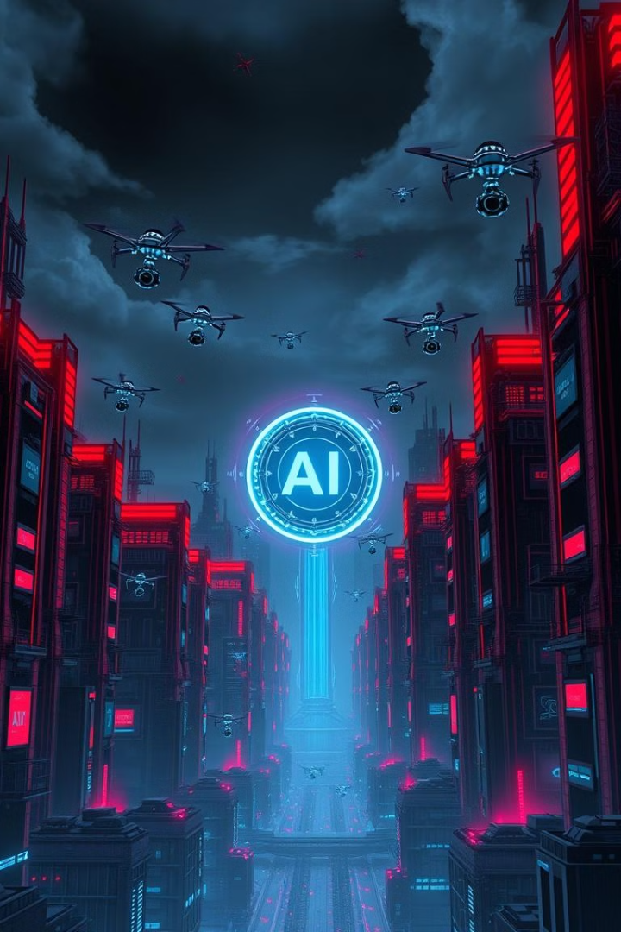
Conclusion: The Transformative Potential of Generative AI
Generative AI is a transformative technology with the potential to reshape various aspects of our lives. It offers exciting possibilities for creativity, innovation, and progress, but it also presents ethical challenges that require careful consideration and responsible development.

